Slide 1
Portfolio Optimization- MPF Scheme
Returns Prediction Using Machine
Learning in Quantitative Trading
Analysts:
Alexandra Law
John Lee
Mena Liu

Slide 2
As a fresh graduate, have you ever thought of …
01
Having x% of MPF returns 20 years after?
You do nothing but just follow what we tell you to earn x% of return.
02
Enjoying comfortable life after retirement?
A comfortable retirement is not a dream for you. Just follow us to make the dream come true.
03
Earning apart from your salary?
Your salary is insufficient for you to spend? You want more without working too hard?
04

Slide 3
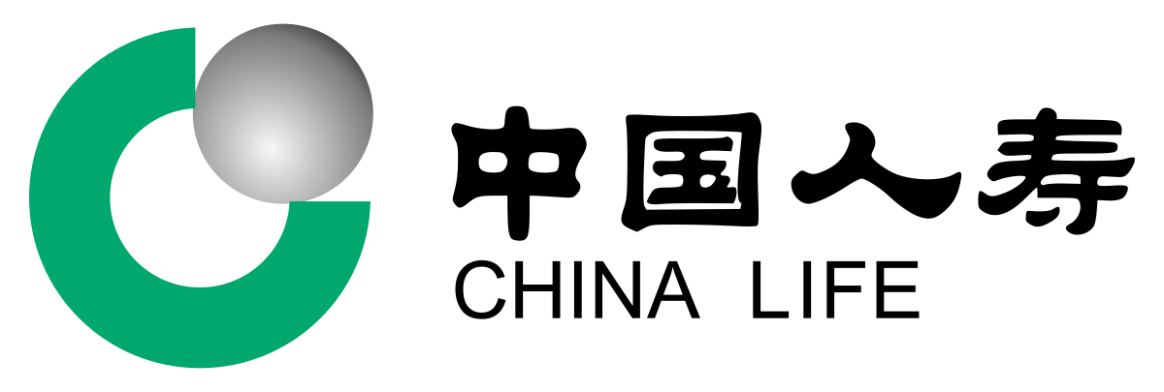

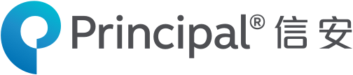
These are 3 MPF providers we focus on for this project
China Life
AMTD
Principal

Slide 4
Model Training- China Life
But the next slide is purely about the data

Slide 5
China Life is providing 9 funds. They are
01
CLMTAGP HK Equity
06
CLHKEQF HK Equity
02
CLMMBAF HK Equity
07
CLMPCOF HK Equity
03
CLMTCOA HK Equity
08
CLREGEF HK Equity
07
04
CLMMGOF HK Equity
07
09
CLREGUF HK Equity
08
08
05
CLMMGRF HK Equity

Slide 6
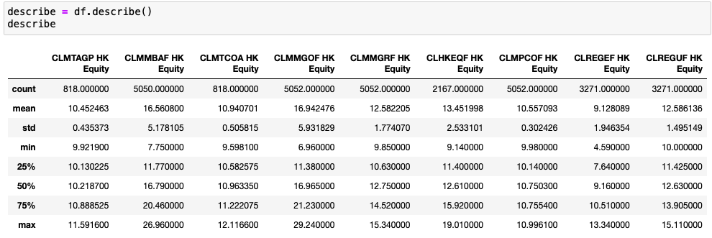
Funds Overview
What are you trying to tell by using this table?

Slide 7
Interpretations of the Statistics
The mean of CLMMGOF HK Equity is the highest
The price of this fund is the largest.
Mean
The standard deviation of CLMMGOF HK Equity is the highest
The mean of CLREGEF HK Equity is the lowest
The price of this fund is the largest
There is a great variability in the price. (the price of this fund differ a lot throughout the period)
The standard deviation of CLMPCOF HK Equity is the lowest
Standard
Deviation
There is a small variability in the price. (the price of this funds remain stable throughout the period)

Slide 8
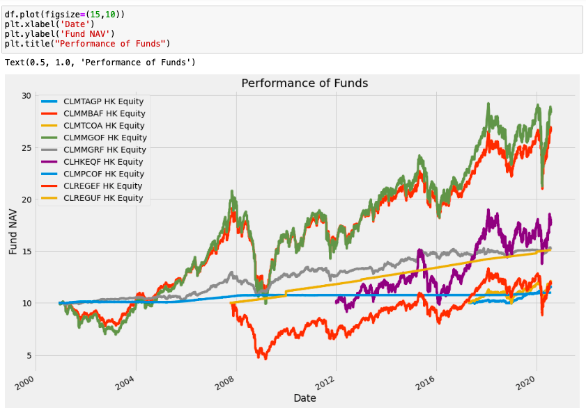
Performance of the 9 Funds
Will you describe the performance ?

Slide 9
Explanations on Significant Changes
2008
The stock market crash occurred on September, 28, 2008.
Major financial markets lost more than 30% of their value
The funds were significantly affected by the stock market and their values decreased sharply.
2020
Coronavirus crash was a sudden global stock market crash began on
February, 20 to April, 7.
S&P 500, the Dow Jones Industrial Average experienced the largest one-day drop since the 2008 financial crisis.

Slide 10
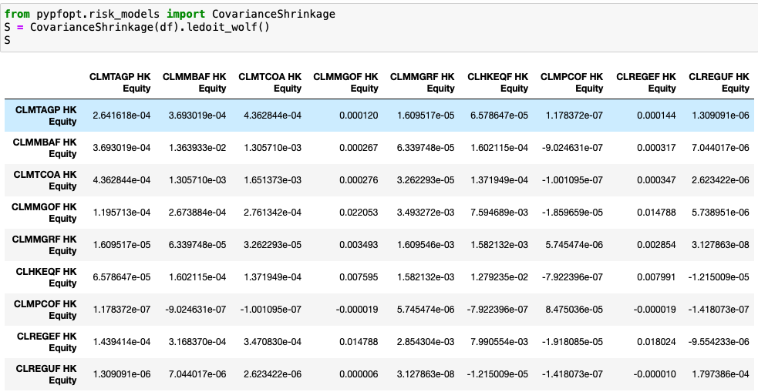
Covariance Matrix Between The Funds
What are you trying to tell by using this table?

Slide 11
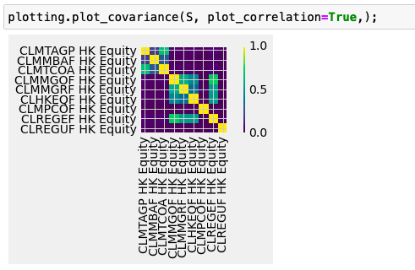
Plot of the Covariances Between The Funds

Slide 12
Explanation on the Covariance Plot
The lighter the squares, the higher correlation between the funds.
CLMTCOA HK Equity and CLMTAGP HK Equity are highly correlated.
CLMMGOF HK Equity and CLREGEF HK Equity are highly correlated.
CLMMGOF HK Equity and CLMMGRF HK Equity are highly correlated.
- Positive relationship is observed within the funds.
Could further investigate how are they correlated, such as the funds composition / any other underlying factors ?

Slide 13
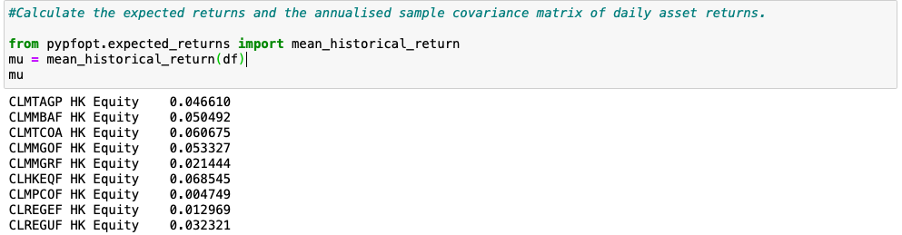
Expected Returns
What does your model do?/ (the objective of the model)
According to our model, the expected returns of the 9 funds are:
CLMTAGP HK Equity 4.6610%
CLMMBAF HK Equity 5.0492%
CLMTCOA HK Equity 6.0675%
CLMMGOF HK Equity 5.3327%
CLMMGRF HK Equity 2.1444%
CLHKEQF HK Equity 6.8545%
CLMPCOF HK Equity 0.4749%
CLREGEF HK Equity 1.2969%
CLREGUF HK Equity 3.2321%

Slide 14
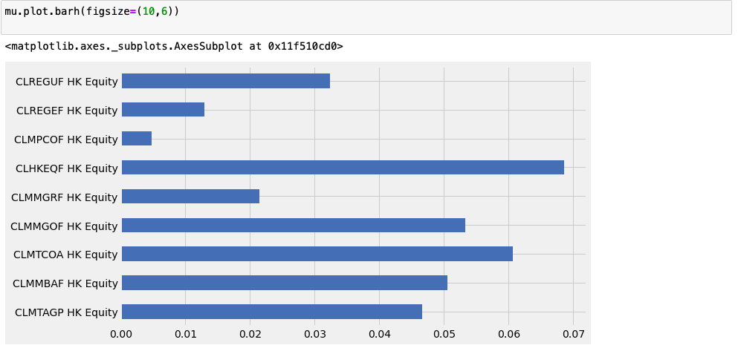
Plot of Expected Returns
A bit confusing, please clarify
Therefore, CLMTCOA HK Equity yields the highest returns among the other 8.

Slide 15
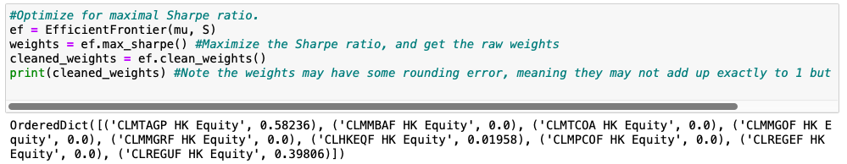
Portfolio Optimization for Maximal Sharpe Ratio
How to allocate funds in a portfolio to get the highest possible returns with the least risk?
Is this the key objective of your model?
Could use graphics to help illustrate how you do with the model design thinking.
To maximize a portfolio with highest Sharpe ratio, our model suggests you allocate 58.2% of MPF
Investment to GLMTAGF HK Equity, 2.0% to CLHKEQF HK Equity and 39.8% to CLREGUP HK Equity

Slide 16
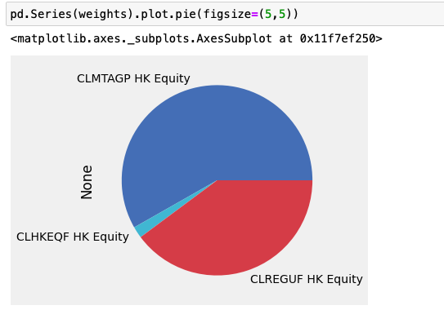
What is the key point of this pie chart?

Slide 17
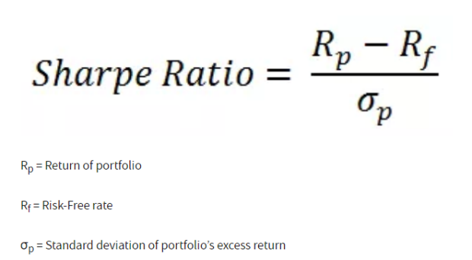
Explanation on the Maximized Portfolio with Maximized Sharpe Ratio
What is Sharpe Ratio?
Sharpe ratio is a very commonly used measure… it is nice to have the formula aside in the deck though.
measures the performance of a portfolio compared to a risk-free market, after adjusting for its risk.
It represents the additional amount of return that an investor receives per unit of increase in risk.
i.e. the higher the Sharpe ratio, the better a portfolio’s returns have been relative to the amount of investment risk it has taken.
Lengthy

Slide 18
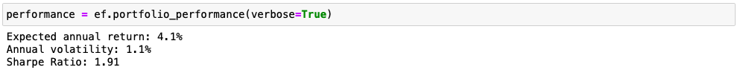
If you follow what our model suggest, how much can you earn ?
Expected outcome? How could you do with this model?
Also, try to be more precise in telling numbers with time and how.
You are expected to earn 4.1% annually, with 1.1% of annual volatility and 1.91 Sharpe ratio.

Slide 19
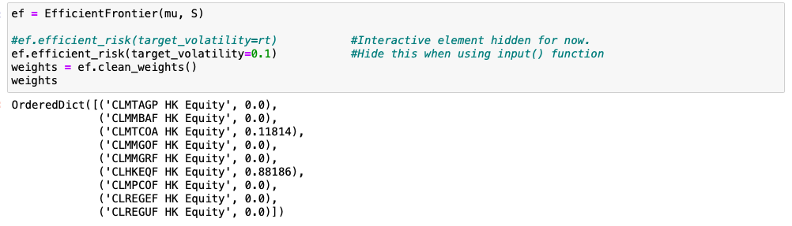
Volatility Constraint – Best Portfolio for You
If you want to keep the volatility within 0.1, what is the best portfolio for you?
Our model show you the best combination of the portfolio given that your volatility is 0.1. (you can change the value of volatility freely)
Our model suggests you allocate 11.8% of MPF Investment to GLMTCOA HK Equity and 88.2% to CLHKEQF HK Equity

Slide 20
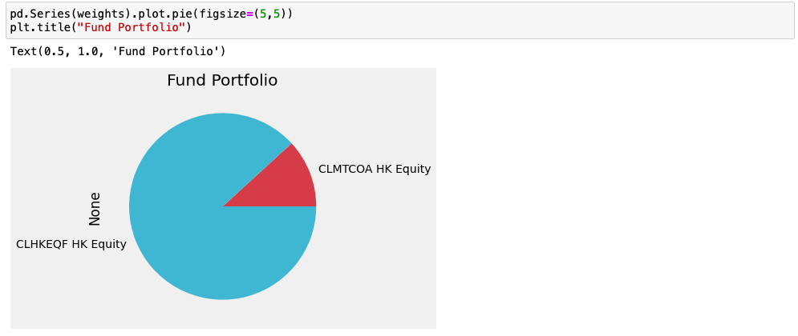

Slide 21
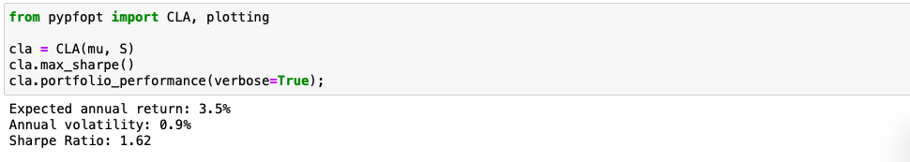
Efficient Frontier

Slide 22
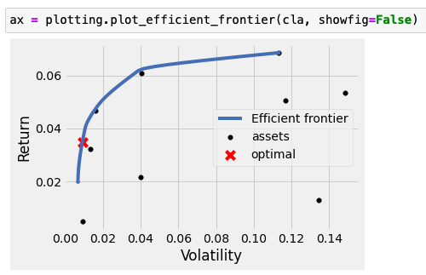
Plot of Efficient Frontier

